Slide 1
Guided Capstone – I
Blue Mountain Resort :
recommendations on recouping the increased operating costs from the new chair this season.

Slide 2
Problem Identification:
Resort has recently installed an additional chair lift, cost of $1,540,000
we need to identify the ideas which could lead to reimburse the amount spent on chair and maintain the annual profit.
The goal is to achieve regain the cost of chair lift without affecting its annual profit and Business is able to manage 9.2% or more profit annually.
Collected data for analysis from 330 resorts in the US that can be considered part of the same market share

Slide 3
Recommendations
To depend on factors on which we have control and we can make change on it on our will.
Avoid making change in factors like No of days open in upcoming session.
Consider increasing the value of ticket prices
I recommend here to increase ticket price for an adult on Weekends from 81 to 86.

Slide 4
Modeling Results and Analysis
I have Standardize the magnitude of numeric features, Split into testing and training datasets and applied scaler to the testing set.
It is observed that ticket price for an adult at Weekend is highly corelated to ticket price for an adult at weekday.
To present further, I have divided the number of resorts into 2 groups (represent data in different color) based on their factor’s property and related data for Big Mountain resort in Red notation.

Slide 5
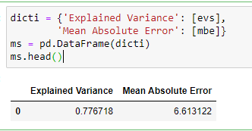
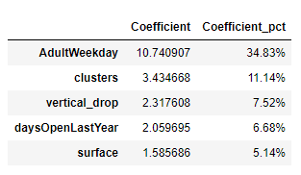
Explained Variance & Mean Absolute Error for Final Model
Mean Absolute Error is is ~6.6.
Explained Variance is used to check model performance
An R-squared value of ~78
Price of an Adult on weekends is highly dependent on price of an Adult on Week day
Followed by Vertical drop feature

Slide 6
coefficients for each Factor
Top import features on which ticket price of an adult on weekend are dependent are ticket price Adult on Weekday, vertical drop for resort, number of days resort was open last year.
Blue mountain resort has its specialty with high vertical drop, therefore increasing ticket price on weekend for an adult could be considered.

Slide 7
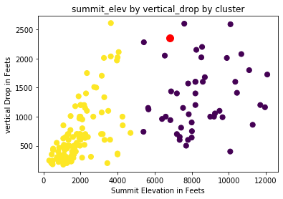
Summit Elevation & Vertical Drop for Blue Mountain Resort (Red Notation) vs Other Resort
From figure, we can conclude that Blue Mountain Resort comes under second group where we have high Summit Elevations and high Vertical Drops.
We are among top resorts if we consider vertical drop factor

Slide 8
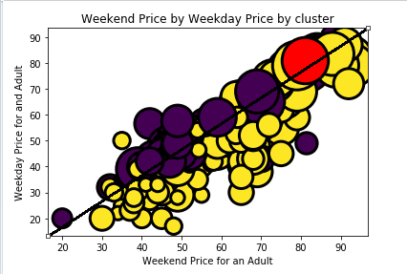
Weekday and Weekend price for Blue Mountain Resort (Red Notation) vs Other Resort
Being among top resorts for vertical Drops ticket prices for our resort are still not high as other resorts.
Increasing ticket price of an adult is the feature can be considered
Increasing Weekend Ticket price would be feasible as it will balance tourists with Weekday price. They can visit to resort as per their priority factors.

Slide 9
Summary and conclusion
Depending on factors like opening days for resort in upcoming session to maintain revenue will not be feasible as there is no control on this feature because we don’t see any this resort could be opened for longer time this year.
To increase/maintain the revenue for Blue Mountain Resort increasing Weekend Ticket price only would be feasible as it will balance tourists with Weekday price. They can visit to resort as per their priority factors.
After analysis on Weekend Ticket price for an adult we see that it is highly depended on feature like Weekday Ticket price for an adult and Vertical Drop of resort.
Being among top resorts for vertical Drops ticket prices for our resort are still not high as other resorts.
Therefore I recommend here to increase ticket price for an adult on Weekends from 81 to 86.

